Slide 1
Life Expectancy {
LifeExpectancy.html
DataAnalytics.css
[Data Analytics Report]
< Group 2 :Ziying Cai, Jake Chadrow, Haoqian Du, Kshitiz Shah, Yuchen Wu >
}
DA Project Group 2

Slide 2
01 {
[Overview]
LifeExpectancy.html
DataAnalytics.css
}
DA Project Group 2

Slide 3
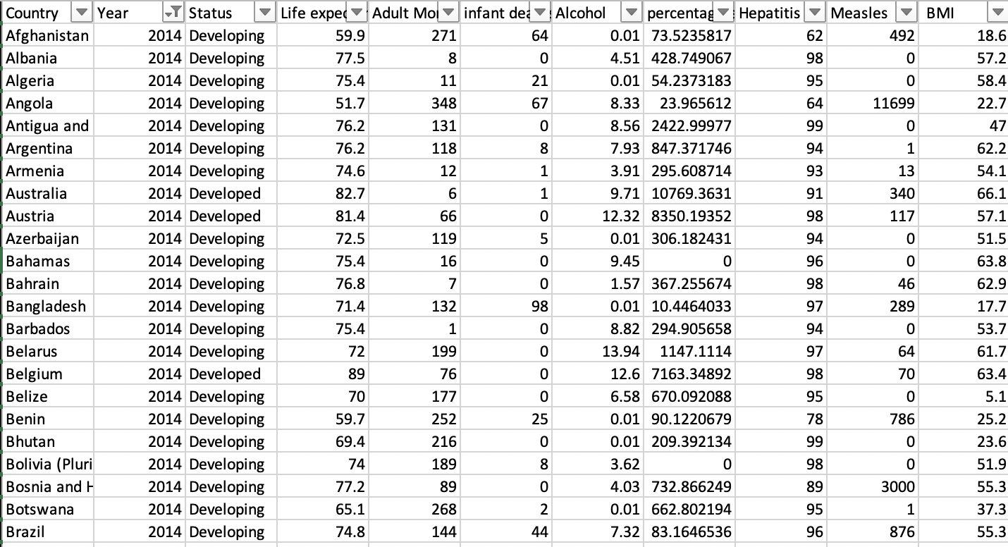
Overview
LifeExpectancy.html
DataAnalytics.css
Culmination of various medical, education, demographic, and social data
Across 193 countries
Sources from the World Health Organization (WHO), Global Health Observatory, and the United Nations (UN).
Note: Previous datasets did not contain immunization information
What can we conclude given this repository of information about the greater population of 193 countries across the world?
DA Project Group 2
Notes:
The dataset used in this report is from a diverse set of organizations, and draws significant conclusions regarding the health, life expectancy, and impactful health habits of citizens across 193 countries.
Some countries are not included due to most of this information not being available for them however.
This information is sourced directly from the World Health Organization and the Global Health Observatory and The economic data in this sheet has been collected by the United Nations.
Together this gives us in depth look at developing and developed nations healthcare expenditure and national health priorities
My group member will dive deeper into the variables shortly but there is a lot of data to work with for our regression model

Slide 4
Question {
LifeExpectancy.html
DataAnalytics.css
What are the factors that contribute to a lower value for life expectancy? Which variables contribute to prolonging it?
}
Hypothesis {
Immunization variables (Hepatitis.B, Measles, Polio, Diphtheria) will be significant in determining life expectancy, along with alcohol use.
}
DA Project Group 2
Notes:
So with all of this information, specifically the health related pieces there is a long list of potential questions we can ask.
For example, do these factors accurately predict life expectancy?
If a country has a low life expectancy value, how should it increase its health expenditure, if at all?
What is the impact of a specific variable on life expectancy?
There is much more but for the sake of time I will cut it here.
Our main question is to look at the significant factors that contribute to life expectancy, the ones that are lowering it as well as which significant variables might be attributed to prolonging life.
Before running the regression and obtaining the results, our group predicted that the immunization variables (Hep B, Measles, Polio, etc) would be significant in prolonging life.
If most of the population is vaccinated for these potentially fatal diseases, it not only protects them but demonstrates the capable medical infrastructure that country may have.
We also predicted alcohol use, as prolonged or extreme alcohol consumption can damage your organs and lead to adverse health effects, shortening ones life.

Slide 5
02 {
[Data Description]
LifeExpectancy.html
DataAnalytics.css
}
DA Project Group 2

Slide 6
General Description {
LifeExpectancy.html
DataAnalytics.css
Global Health Observatory (GHO) keeps track of the health status as well as many other related factors for all countries
Health dataset for 193 countries from 2000 to 2015
2938 rows (data points) and 22 columns (features)
}
DA Project Group 2

Slide 7
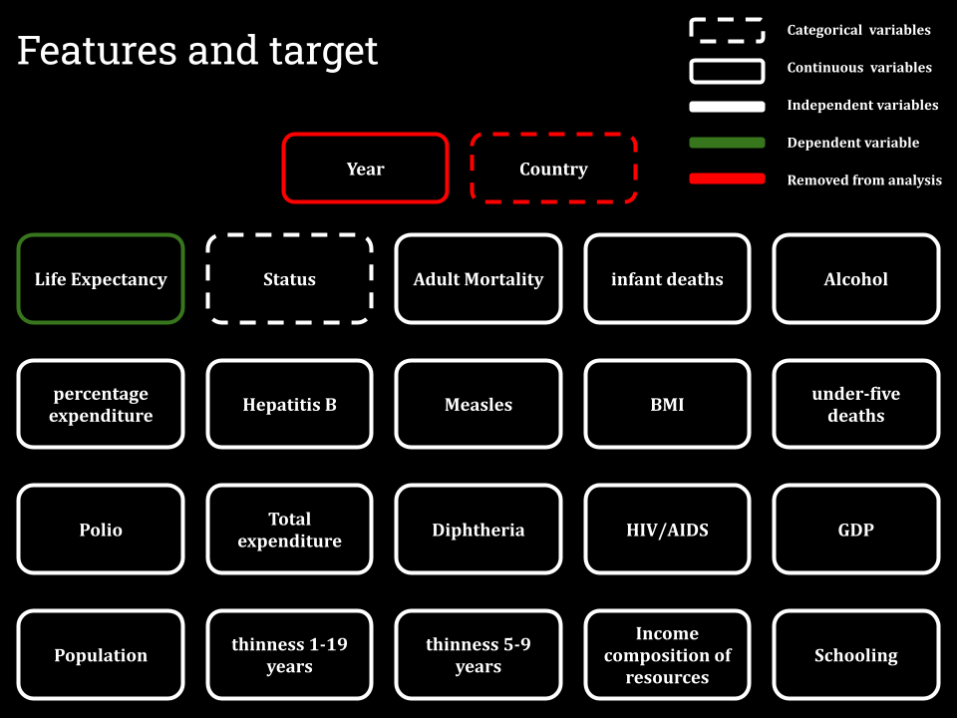
LifeExpectancy.html
DataAnalytics.css
}
DA Project Group 2

Slide 8
03 {
[Methodology]
LifeExpectancy.html
DataAnalytics.css
}
DA Project Group 2

Slide 9
Model { Selection
LifeExpectancy.html
DataAnalytics.css
}
DA Project Group 2
Notes:
Thank you Haoqian. Next I’m gonna talk about model selection for our project

Slide 10
Forward Stepwise Selection
LifeExpectancy.html
DataAnalytics.css
There are 19 predicting variables in total. Using best subset selection method takes significant amount of time, so forward stepwise selection is used
Adjusted R2, BIC, Cp were used as measures of best models
Resulting Best Number of Predicting variables:
Adjusted R2: 15 variables
BIC: 9 variables
Cp: 13 variables
DA Project Group 2
Notes:
In our project, we used forward stepwise selection, because there 19 predicting variables and running all possible models take a large amount of time, so we choose forward stepwise selection for both efficiency and accuracy
We looked at the best number of predicting variables separately using three different measures, which are adjusted R2, BIC, and Cp. The corresponding best numbers of predicting variables are 15 variables, 9 variables, and 13 variables

Slide 11
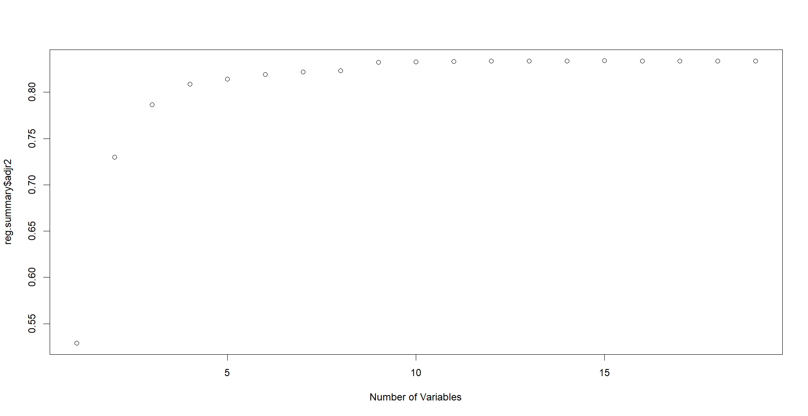
Plot of number of variables and adjusted R2
LifeExpectancy.html
DataAnalytics.css
Notes:
This is a plot of adjusted R2 and number of variables. Adjusted R2 is maximized when there are 15 number of variables

Slide 12
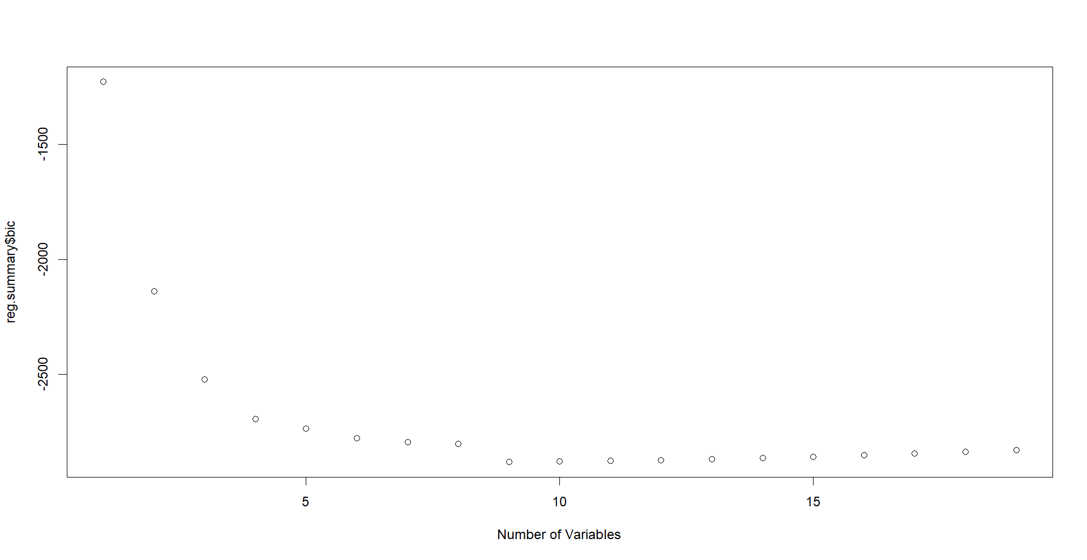
Plot of number of variables and BIC
LifeExpectancy.html
DataAnalytics.css
Notes:
This is a plot of BIC and number of predicting variables. BIC is minimized when there are 9 variables

Slide 13
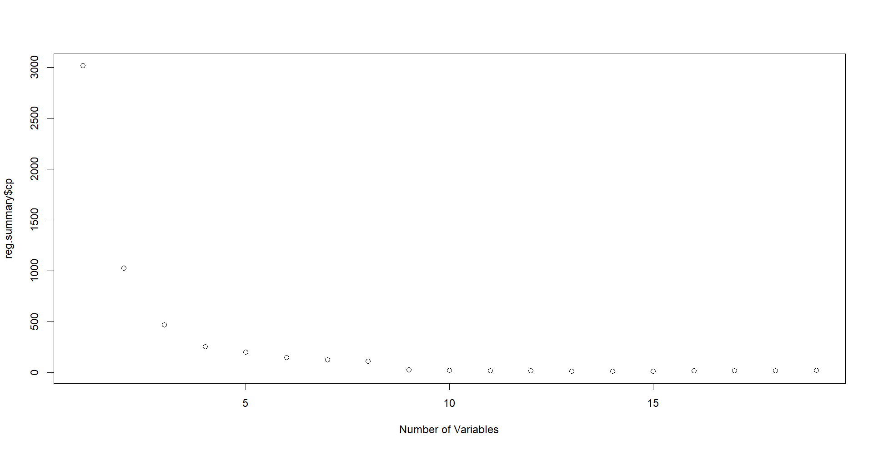
Plot of number of variables and Cp
LifeExpectancy.html
DataAnalytics.css
Notes:
Finally this is a graph of Cp and number of variables. Cp is minimized at 13 variables. Now I will pass it on to Ziying to talk about our Linear Regression Model

Slide 14
Linear {
Model
LifeExpectancy.html
DataAnalytics.css
}
DA Project Group 2

Slide 15
LifeExpectancy.html
DataAnalytics.css
To determine the relevance and strength of the predictors
linear model using command lm(Life.expectancy~.-Status, data=data)
19 predicting variables
15,9 and 13 best variables were selected according to model selection respectively to compare the results
DA Project Group 2

Slide 16
Tree {
Model
LifeExpectancy.html
DataAnalytics.css
}
DA Project Group 2

Slide 17
LifeExpectancy.html
DataAnalytics.css
Why trees?
Decision trees are easy to understand and interpret: The "if-then" rules that form the basis of decision trees make it easy for people to understand how the model is making its decisions.
Decision trees can handle both continuous and categorical data: Decision trees can handle a mix of different types of data, making them a flexible choice for many machine learning tasks.
Decision trees are fast: Decision trees are relatively fast to train and make predictions with, which makes them practical for large datasets.
Decision trees are scalable: Decision trees are relatively simple models, so they can be trained on very large datasets without requiring a lot of computational resources.
DA Project Group 2

Slide 18
LifeExpectancy.html
DataAnalytics.css
How did we use trees?
Used decision tree models to predict life expectancy for a test sample
Conducted cross-validation to ensure robustness of model and mitigate risk of overfitting
Determined that decision tree with 9 nodes resulted in lowest test error, calculated as sqrt(mean((yhat - tree.test)^2))
Code: used the ‘tree’ library:
# train
tree = tree(Life.expectancy~., data=data, subset=train)
# prediction
tree.test= data$Life.expectancy[-train]
yhat = predict(tree, newdata=data[-train,])
DA Project Group 2

Slide 19
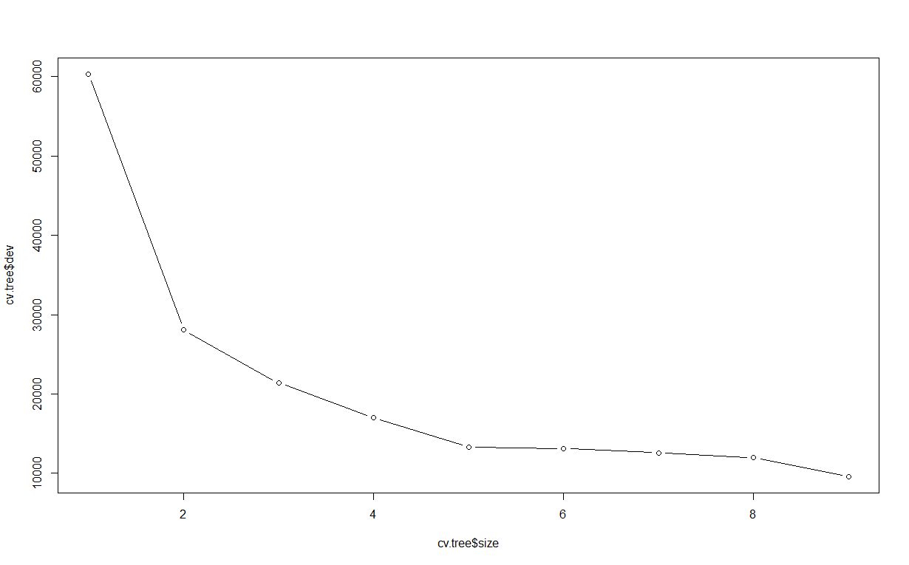
LifeExpectancy.html
DataAnalytics.css
Cross Validation
DA Project Group 2

Slide 20
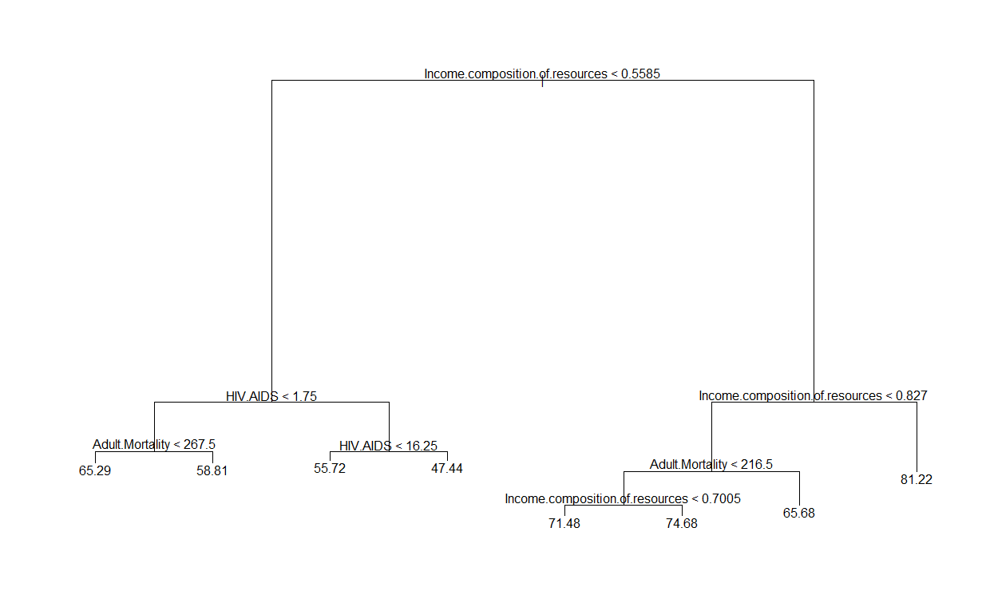
LifeExpectancy.html
DataAnalytics.css
Tree Diagram
DA Project Group 2

Slide 21
04 {
[Results]
LifeExpectancy.html
DataAnalytics.css
}
DA Project Group 2

Slide 22
LifeExpectancy.html
DataAnalytics.css
Linear Model {
Overall a good model <— F-statistic:436, Adjusted R2:0.834, P-value:2e-16
11 significant predicting variables
Y = 5.45E+01 + X1*(-1.66E-02) + X2*（9.35E-02) + X3*(-9.14E-02) + X4*(3.67E-04) +X5*(3.38E-02) + X6*(-7.03E-02) + X7*(1.49E-02) + X8*(-4.37E-01) + X9*(9.82E+00) + X10*(8.67E-01) +X11*(-9.68E-01)
X1:Adult.Mortality, X2:infant.deaths, X3:Alcohol, X4:percentage.expenditure, X5:BMI, X6:under.five.deaths, X7:Diphtheria, X8:HIV.AIDS, X9:Income.composition.of.resources, X10:Schooling, X11:Status
DA Project Group 2

Slide 23
05 {
[Conclusion]
LifeExpectancy.html
DataAnalytics.css
}
DA Project Group 2

Slide 24
Effect of Immunization & Alcohol
The effect of immunization is not significant except Diphtheria, but alcohol has a significantly negative effect on life expectancy

Slide 25
Thank You

